Slide 1
Hypothyroid Prediction
CS513-B Knowledge Discovery & Data Mining
Final Project , Fall ‘16

Slide 2
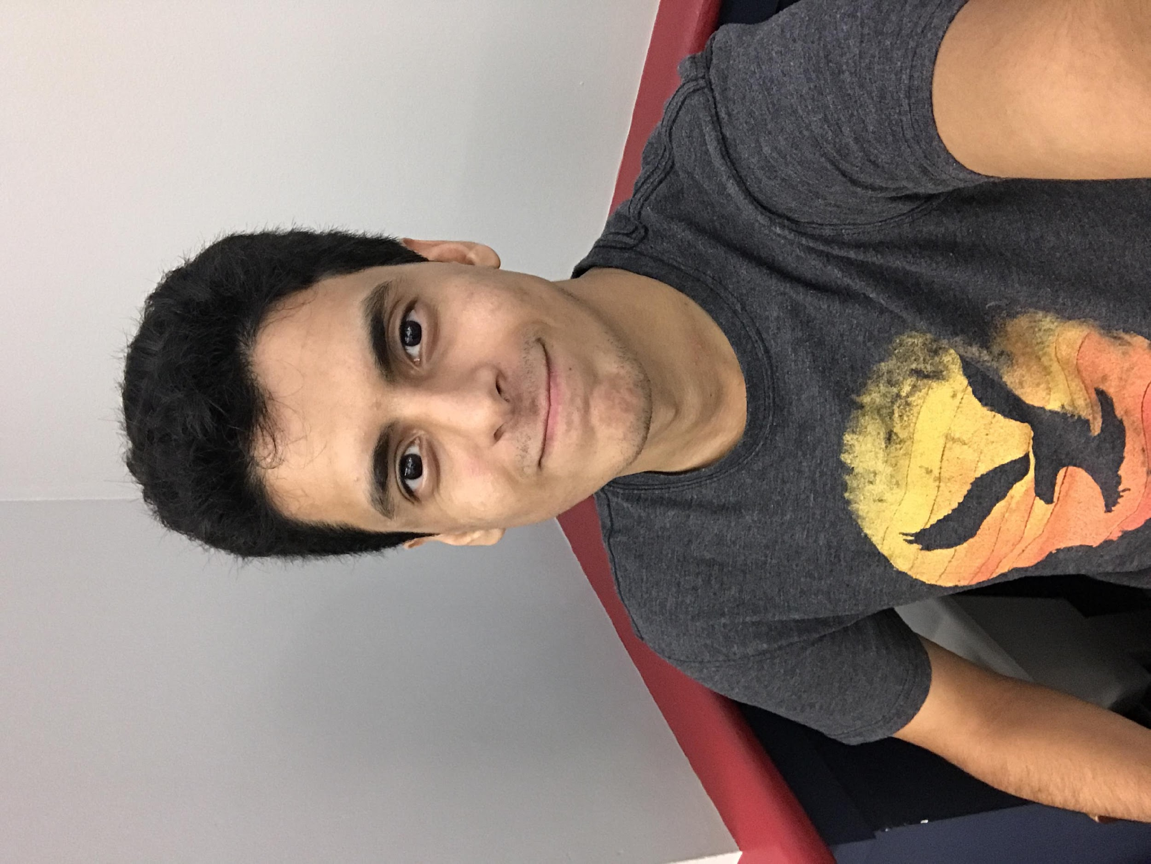


Data Diggers
Majed Hariri
Palak Gangwal
Siddharth Limaye

Slide 3
Outline
Summary
Introduction
Data Cleaning
KNN / KKNN
Decision Trees
Data Visualizations
Challenges
Team Management

Slide 4
Majed Hariri
Introduction and Data Cleaning

Slide 5
Summary / Problem Statement
The dataset was downloaded from http://mldata.org/repository/data/viewslug/datasets-uci-hypothyroid/
The Dataset contains 21 attributes, more than 7000 instances, and it has missing values.
This program predicts outcome of Hypothyroid on the basis of number of attributes.

Slide 6
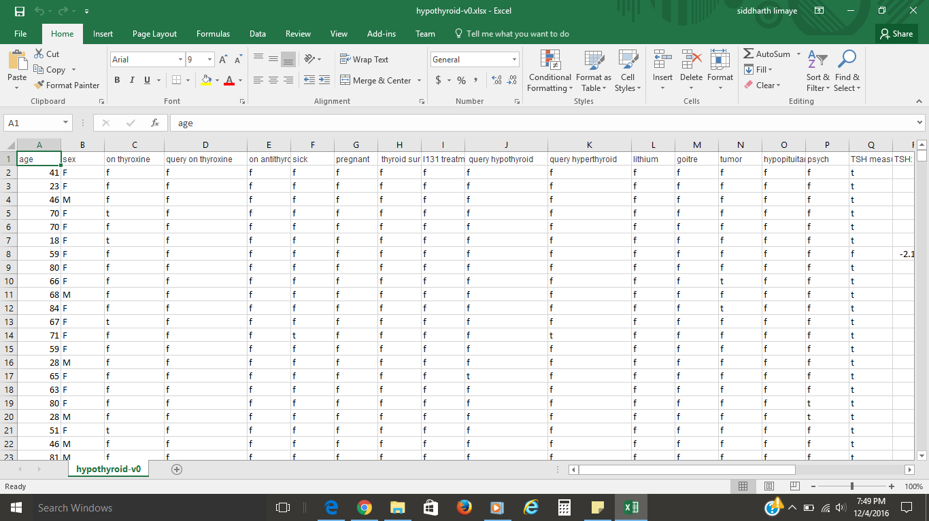
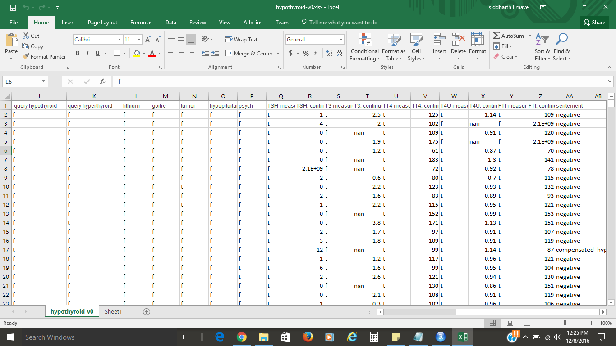
Original dataset from mldata.org

Slide 7
Data attributes
age | age of patient
gender | gender of patient
on thyroxine | indicates whether the patient is under thyroxine medication.it is used to treat an underactive thyroid(hypothyroid) It replaces or provides more thyroidhormone
sick | indicates whether patient is sick during the thyroid tests were performed
pregnant | indicates whether patient is pregnant during the thyroid tests were performed
lithium | indicates whether patient is/was undergoing any lithium treatment.Lithium can cause goiter and hypothyroidism.
goitre | simply refers to the abnormal enlargement of the thyroid gland.A goiter indicates there is a condition present which is causing the thyroid to grow abnormally.

Slide 8
Data attributes
var_measured | indicates whether that attribute was measure or not
var continuous | displays that attributes measured levels.Continuous attributes are typically represented as floating-point numbers.
TSH_measured / TSH_continuous | A thyroid-stimulating hormone (TSH) blood test is used to check for thyroid gland problemsThyroid-stimulating hormone (TSH) stimulates the production and release of T4 (primarily) and T3
T3_measured / T3_continuous | The thyroid produces a hormone called triiodothyronine, known as T3
T4_measured /T4_continuous | thyroxine harmone.T4 is a hormone that plays a role in several body functions, including growth and metabolism
TT4_measured / TT4_continuous | total T4test: A total T4 test measures the T4 that has bonded to protein and the free T4. A free T4 test measures only the free T4 in your blood.

Slide 9
Data attributes
T4U_measured / T4U_continuous | The amout of iodine that goes into thyroid gland can be measured by T4 uptake..The original test for estimating the level of binding proteins was called the T3-uptake test and later versions were called T-uptake methods. These are rarely used now that there are methods available to measure free T4 and T3 directly
FTI_measured / FTI_continuous | FTI stands for the Free Thyroxine Index and it is an estimation of the free T4 concentration.Free thyroxine (free T4) tests are used to help evaluate thyroid function and diagnose thyroid diseases, including hyperthyroidism and hypothyroidism, usually after discovering that the thyroid stimulating hormone (TSH) level is abnormal.

Slide 10
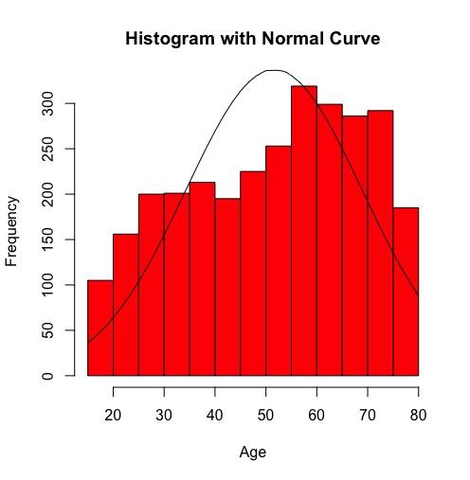
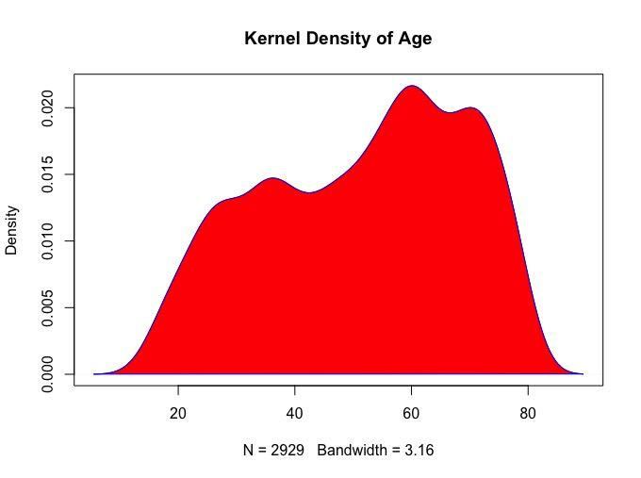
Age Field
We have only age group from 15-80

Slide 11
Majed Hariri
Data Cleaning

Slide 12
Data Cleaning Process :
We had a challenge to convert String to numbers, and divide existing fields into zones.
Deletion and replacement of null values by the use of average values for the age filled .
Deleted the null values for gender and other related fields.
Initially the data consisted of various true /false values which we changed it to binary values 1 for true and 0 for false
Divides the age group into four zones.
Separated all the values on all other attributes on the basis of quartiles in 4 zones

Slide 13
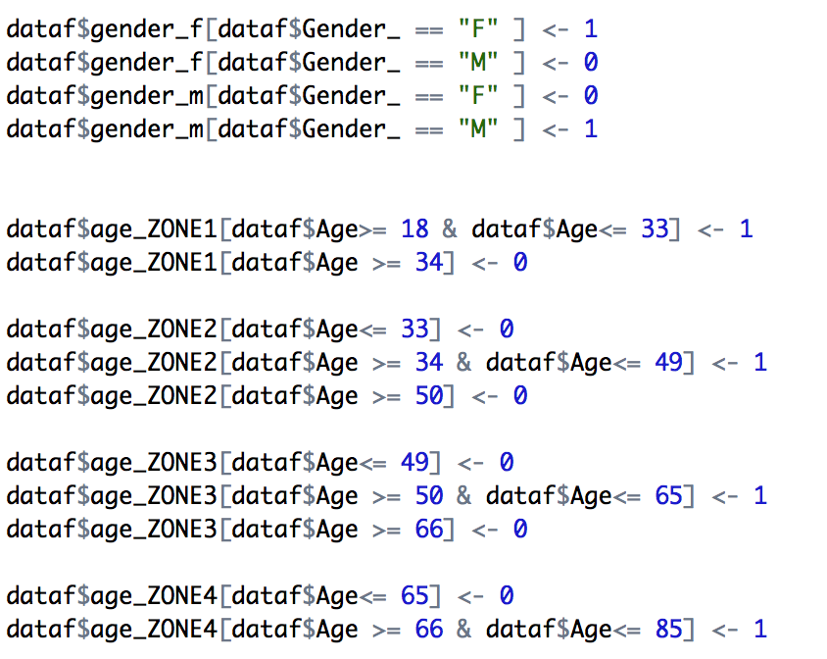
Data Cleaning Continue
Categorization and factorization were implemented to provide equal weightage to different variables
age -> zone1,zone2,zone3,zone4
gender -> gender_m, gender_f
TSH_continuous -> zone1,zone2,zone3,zone4
TT4_continuous -> zone1,zone2,zone3,zone4
T4U_continuous -> zone1,zone2,zone3,zone4
FTI_continoue -> zone1,zone2,zone3,zone4
predict_thyroid -> 0 if no; 1 if yes

Slide 14
Data Cleaning
Relevant variables | Irrelevant variables
age | referral sources
gender | tbg_continuous
sick | tgb_measured
pregnant | psych
lithium | I131_treatment
goitre | thyroid_surgery
tumor | on_antithyroid_medication
THS_continuous
T3_continuous
TT4_continuous
T4U_continous
FTI_continous
predict_thyroid

Slide 15
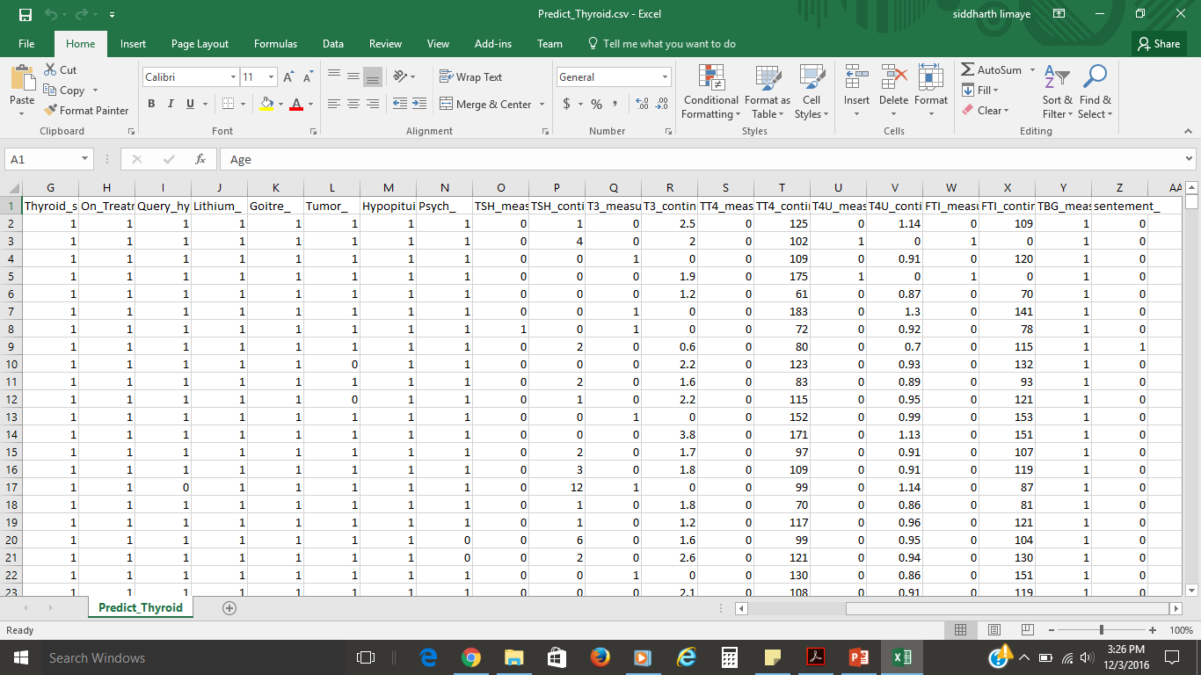
Cleaned Dataset

Slide 16
Packages Used
knn
kknn
rpart
rpart.plot
hexbin

Slide 17
Palak Gangwal
KNN & KKNN

Slide 18
Why Knn and Kknn
Effective for large training dataset
Robust with regard to the search space
Few parameters to tune: distance metric and k
Non parametric lazy algorithm - it does not make any assumptions on the underlying data distribution

Slide 19
KNN
kNN stands for k - Nearest Neighbor
kNN does not make any assumptions on the underlying data distribution.
The k-Nearest Neighbor algorithm is an example of instance-based learning where training set records are first stored
Next, the classification of a new unclassified record is performed by comparing it to records in the training set it is most similar to
k-Nearest Neighbor is used most often for classification, although it is also applicable to estimation and prediction tasks

Slide 20
KNN cont...
A case is classified by a majority vote of its neighbors, with the case being assigned to the class most common amongst its K nearest neighbors measured by a distance function.
If K = 1, then the case is simply assigned to the class of its nearest neighbor.
Choosing the optimal value for K is best done by first inspecting the data.

Slide 21
KNN use in project
library(class)
?knn()
newpredict<-knn(newtraining[,-32], newtest[,-32],newtraining[,32],k=1)
newresults<-cbind(newtest,as.character(newpredict)) # adds new column from the result
table(newresults[,32],newresults[,33])
df<-as.data.frame(table(newresults[,32],newresults[,33]))
good_predictions<-sum(df$Freq[df$Var1==df$Var2])
total_predictions<- sum(df$Freq)
successrate_K_1 <- (good_predictions/total_predictions) * 100
successrate_K_1

Slide 22
KNN Results
K value | success rate %
1 | 89.59044
3 | 90.95563
5 | 91.80887
7 | 91.97952
9 | 91.80887
11 | 91.97952
13 | 92.66212
15 | 92.32082

Slide 23
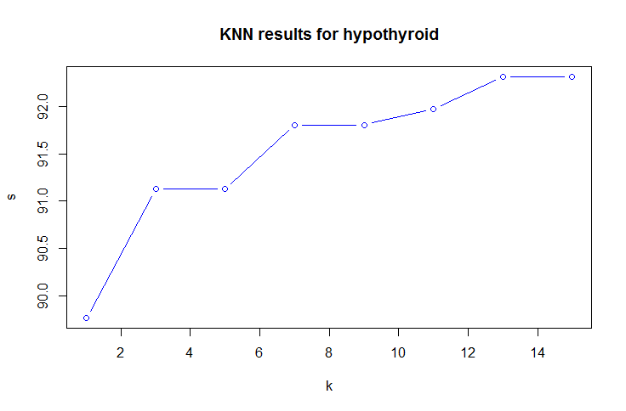
KNN Result Plot
k<-c(1,3,5,7,9,11,13,15)
s<-c(successrate_K_1, successrate_K_3,successrate_K_5,successrate_K_7,successrate_K_9,successrate_K_11,successrate_K_13,successrate_K_15)
ks<-cbind(k,s)
plot(ks,col="blue")

Slide 24
Palak Gangwal
KKNN

Slide 25
KKNN (weighted knn)
Since KNN predictions are based on the assumption that objects close in distance are potentially similar.
It makes good sense to discriminate between the K nearest neighbors when making predictions, i.e., let the closest points among the K nearest neighbors have more say in affecting the outcome of the query point.
library(class)
library(kknn)
newpredict <- kknn(sentement_~., newtraining, newtest, distance=1,k=1)
fit <- fitted(newpredict)
s<-table(newtest$sentement_, fit) # table gives the result in tabular form
df1<-as.data.frame(s)
good_predictions<-sum(df$Freq[df$Var1==df$Var2])
total_predictions<- sum(df$Freq)
successrate_KKNN_1 <- (good_predictions/total_predictions) * 100
successrate_KKNN_1

Slide 26
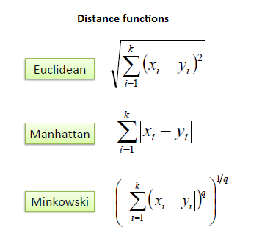
Distance Function

Slide 27
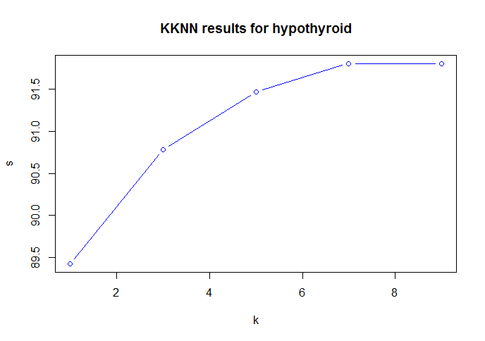
KKNN Result Plot
k<-c(1,3,5,7,9)
s<-c(successrate_K_1,successrate_K_3,successrate_K_5,successrate_K_7,successrate_K_9)
ks<-cbind(k,s)
plot(ks,col="blue",main = "KKNN results for hypothyroid",type="b")

Slide 28
Siddharth Limaye
Decision Tree

Slide 29
What Is Decision Tree !!
A decision tree is a schematic, tree-shaped diagram used to determine a course of action or show a statistical probability.
Each branch of the decision tree represents a possible decision, occurrence or reaction.
Decision trees give people an effective and easy way to understand the potential options of a decision and its range of possible outcomes. A decision tree is a structure that includes a root node, branches, and leaf nodes.
Each internal node denotes a test on an attribute, each branch denotes the outcome of a test, and each leaf node holds a class label.

Slide 30
Why Decision Tree
The benefits of having a decision tree are as follows −
It does not require any domain knowledge.
It is easy to comprehend.
The learning and classification steps of a decision tree are simple and fast.

Slide 31
Modified cleaned data set
We modified our relevant data attributes for decision tree
Divided the data attributes based on quartiles and made four zones.
Initially zones were assigned binary values
For decision tree binary not good decision
Replaced binary with 1,2,3,4 based on quartile
Used the same csv file with the above changes

Slide 32
Code Snippet
dtm<- rpart(predict_thyroid ~ age_ZONE1+age_ZONE2+age_ZONE3+age_ZONE4+
T3_ZONE1+T3_ZONE2+T3_ZONE3+T3_ZONE4+
TT4_ZONE1+TT4_ZONE2+TT4_ZONE3+TT4_ZONE4+
T4U_ZONE1+T4U_ZONE2+T4U_ZONE3+T4U_ZONE4+
FTI_ZONE1+FTI_ZONE2+FTI_ZONE3+FTI_ZONE4,newtraining,method = "class")
rpart.plot(dtm,type = 4,extra =102)
title("Decision tree for hypothyroid",line = 3)
rpart.plot(dtm,type = 4,extra =102,branch=0)
title("Decision tree for hypothyroid",line = 3)
summary(dtm)

Slide 33
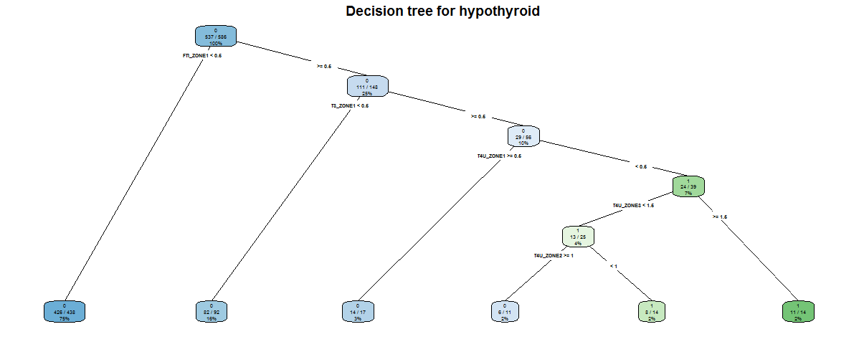
Decision Tree Results

Slide 34
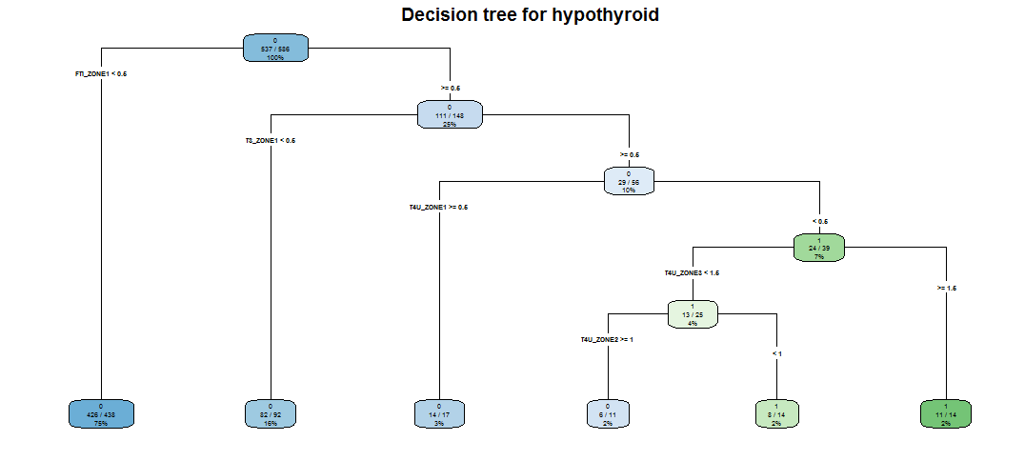
Decision Tree Results

Slide 35
Siddharth Limaye
Data Visualization

Slide 36
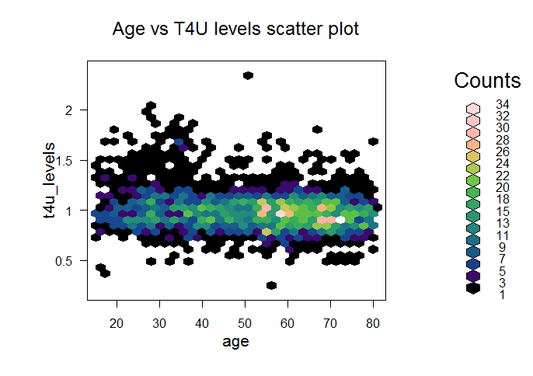
R Graphs

Slide 37
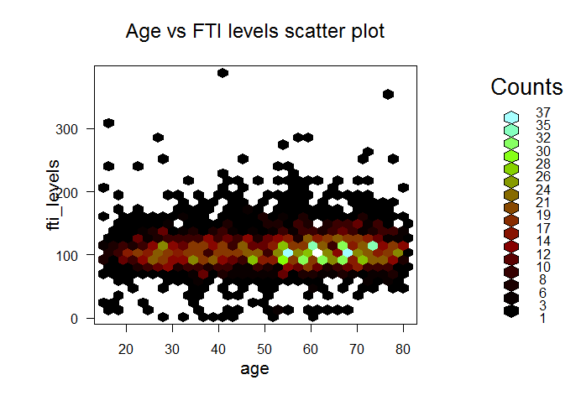
graph cont...

Slide 38
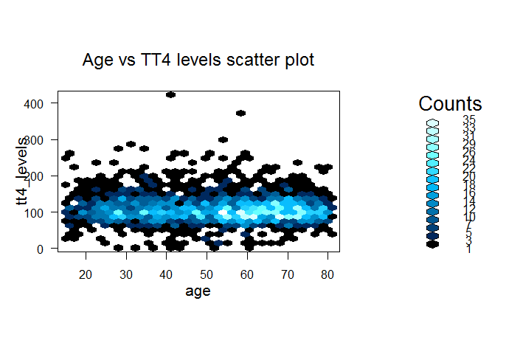
graph cont...

Slide 39
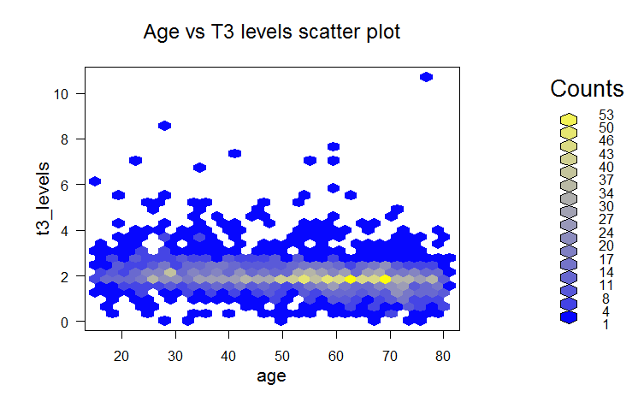
graph cont...

Slide 40
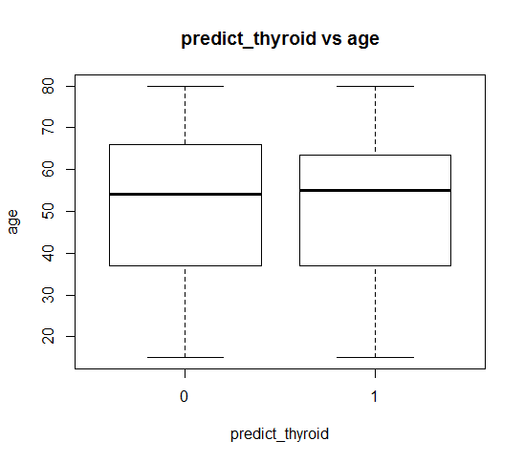
graph cont...

Slide 41
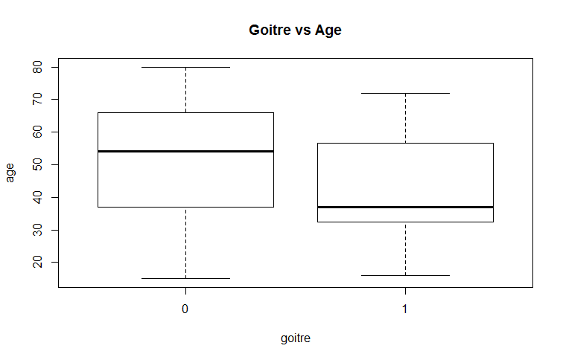
graph cont...

Slide 42
Siddharth Limaye
Challenges / Team Management

Slide 43
Challenges / Risks
Initial idea -
Predict fragile state index based on various factors
too many factors affecting target value
required implementing time lapse concept in R
great idea but limited time and increased complexity
out of scope of curriculum
Current idea -
predict hypothyroid
understanding medical attributes
relevant and irrelevant attributes
which data mining method can be used
data visualizations

Slide 44
Team management
Majed Hariri - Data cleaning , data analysis,code,presentation
Palak Gangwal - Data analysis, code, presentation
Siddharth Limaye - Data cleaning , code, data analysis,presentation

Slide 45
Thank you!

